Slide 1


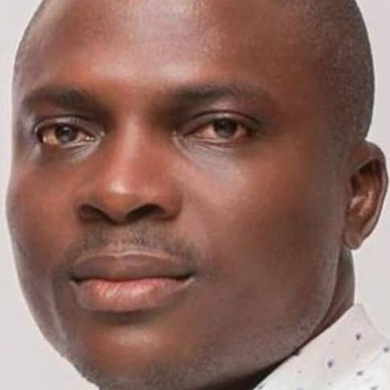
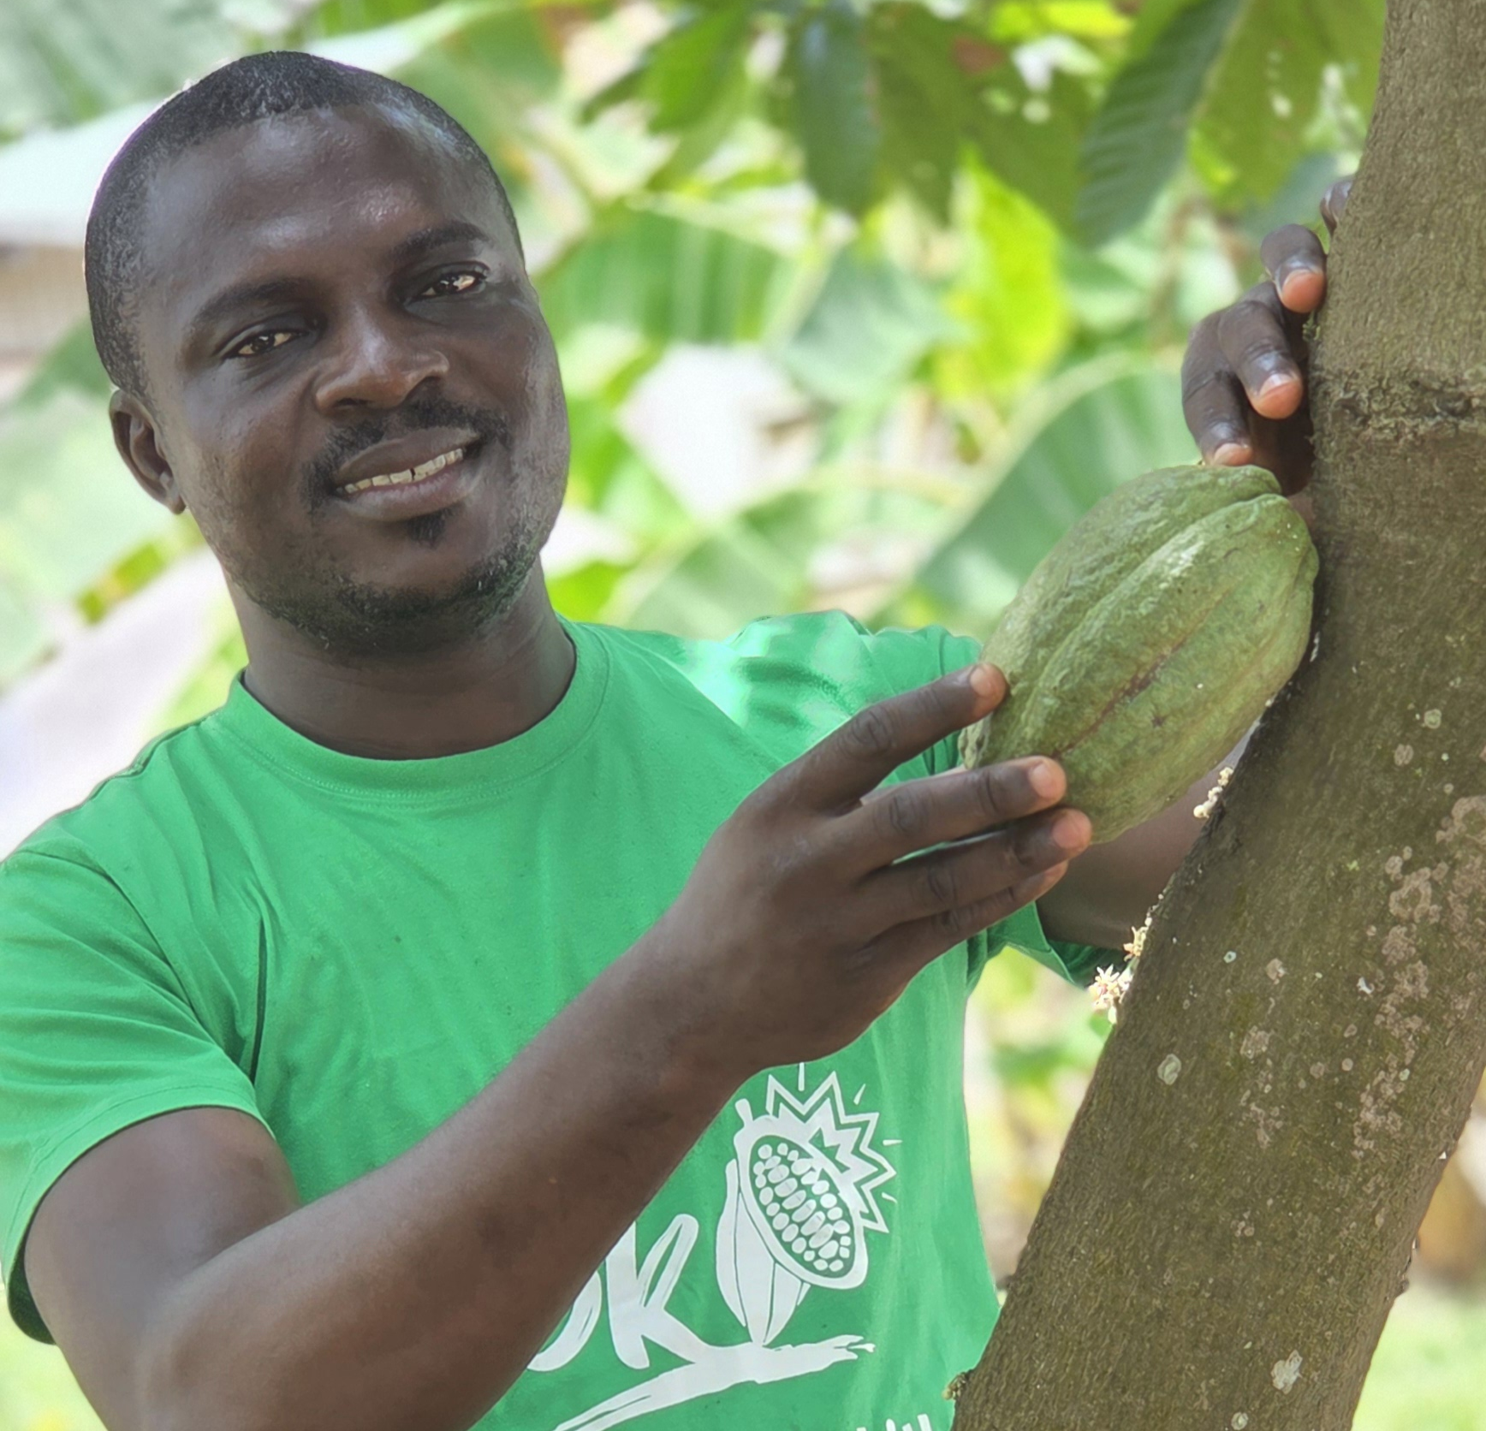
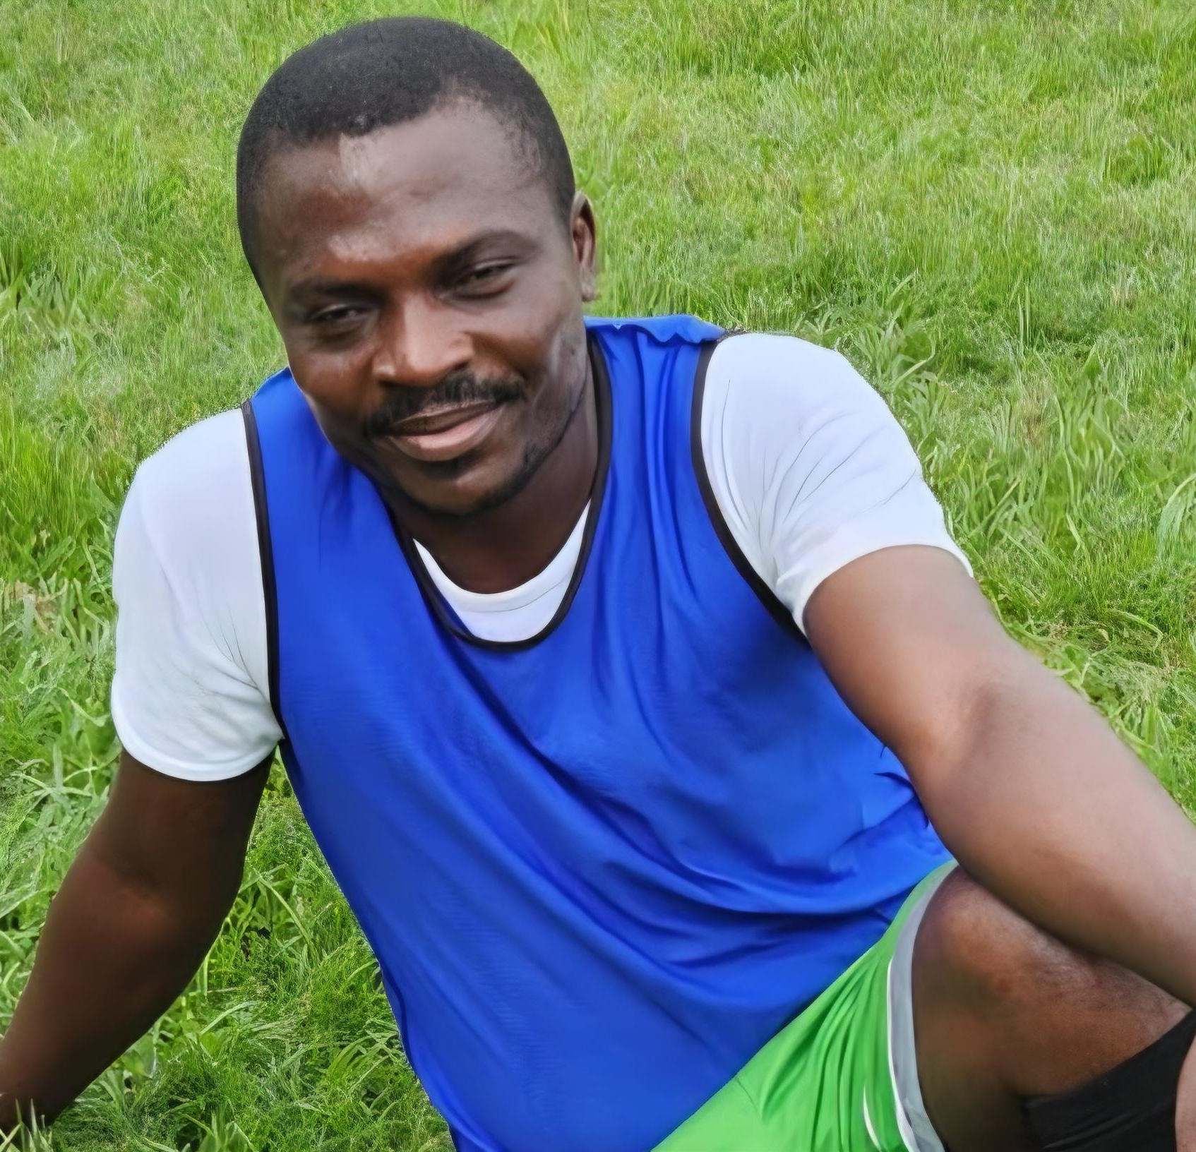
Getting to Know Me
Work
Personal
My role
Ensure Plant availability and infrastructure maintenance
Significant others / family members / furry friends in my life
Joel Ayandokon – Processing Head, Ofi IVC
Smart Darkwah Frimpong – Global Operation process implementation lead at Cargill cocoa
Tenure in ofi/Olam
Year 2009 till date, total of 16 years
How I enjoy spending my free time
I love swimming, Exploring nature site – peace walk through forest and the sea shores.
Previous companies I have worked at
Barry Callebaut Ghana, from 2001 – 2007 (6years)
Cargill Ghana, from 2007 -2009 (1year)
My favorite / comfort food
Rice and Beans
Why I joined ofi/Olam and what keeps me here?
I joined Ofi of it unique approach to Agrobusiness and its focus on sustainability. Overtime I’ve stayed because of the collaborative culture and opportunities, and my work is making impact.
My favorite song
I shot the Sheriff by Bob Marley
Robert Amoasi
‘Robb’
I am unofficial comic Relief chief –my risky jokes boost morale
2. My Best ideas strike in shower my chamber and not meetings
I'm the unofficial "Chief of Comic Relief" during serious meetings — my jokes walk a fine line, but they keep the t
This is me outside work, doing stuff I enjoy in my life …

